Slide 1
Abnormal driving detection using GPS Data
Charles Boateng, KwangSoo Yang, Seyedeh Gol Ara Ghoreishi, Jinwoo Jang, Muhammad Tanveer Jan, Joshua Conniff, Borko Furht, Sonia Moshfeghi, David Newman, Ruth Tappen, Jinnan Zhai, Monica Rosseli

Slide 2

Outline
Motivation
Problem Definition
Related Work
Contribution
Our approach:
Experiment and Validation
Case Study
Conclusion and future work

Slide 3

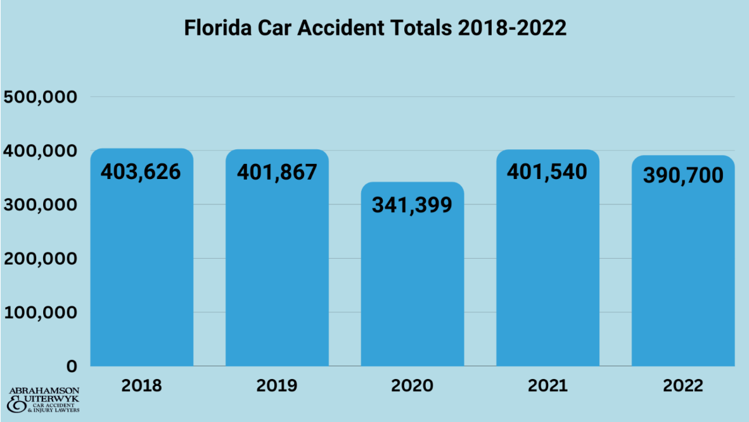
Motivation
Notes:
NSGP is important in many societal applications such as identifying patterns in spatial graph data where each node is associated with additional information.
One such application is discovering communities in the spatial graph of a city by finding partitions where attributes of the population (e.g., average age, income, education, etc.) are similar and the nodes are spatially close to one another.
The NSGP problem is important for many societal applications such as identifying homogeneous communities in a spatial graph and detecting interrelated patterns in traffic accidents.
This information can then be used to better identify and target these communities.
Another application is for Hydrological Response Unit delineation that helps us to understand the spatial variability of the watershed among soil, land use, and topographic characteristics.
The size constraint allows for flexibility in the partitioning, allowing for more focus to be placed on homogeneity over balanced-size partitions if desired.
The high-level intent of NSGP is to identify groups of nodes that are related both structurally in the graph and in their attributes.

Slide 4
Motivation
Application Benefit of Abnormal driving detection using GPS Data
Driver Conduct Insights Identify patterns such as distracted driving, drowsy driving and signs of impaired driving.
Elderly and Dementia Care Assisting older drivers with dementia.
Insurance Risk Assessment Insurance companies can accurately evaluate a driver’s record.
Optimizing emergency Valuable tool in optimizing emergency response response strategies.
Notes:
NSGP is important in many societal applications such as identifying patterns in spatial graph data where each node is associated with additional information.
One such application is discovering communities in the spatial graph of a city by finding partitions where attributes of the population (e.g., average age, income, education, etc.) are similar and the nodes are spatially close to one another.
The NSGP problem is important for many societal applications such as identifying homogeneous communities in a spatial graph and detecting interrelated patterns in traffic accidents.
This information can then be used to better identify and target these communities.
Another application is for Hydrological Response Unit delineation that helps us to understand the spatial variability of the watershed among soil, land use, and topographic characteristics.
The size constraint allows for flexibility in the partitioning, allowing for more focus to be placed on homogeneity over balanced-size partitions if desired.
The high-level intent of NSGP is to identify groups of nodes that are related both structurally in the graph and in their attributes.

Slide 5
Problem Definition
Input: A dataset of driving segments, each comprising timestamped spatial points and GPS-derived features (sog, cog, lon, lat) with:
a set of derived driving features including the normalized change for the speed over ground (S), course over ground (C), longitude (lon), and latitude (lat).
Output: Abnormal Driving Detection (ADD)
Objective:
Minimize the dissimilarity between driving records by partitioning them into two distinct homogeneous groups.

Slide 6
Basic Concepts
GPS Driving Features
Longitude is the measurement of how far east or west a point is from the Prime Meridian
Latitude is the measurement of how far north or south a point is from the Equator.
COG stands for Course Over Ground. It is the direction in which the vehicle is heading, measured in degrees.
SOG stands for Speed Over Ground. It is the speed of the vehicle irrespective of external factors like currents or wind. , measured in knots.

Slide 7
Related Work
Abnormal Driving Detection
Generative Data Models
Real World Data
Hidden Markov Models
Gaussian Mixture Models
Our Approach

Slide 8
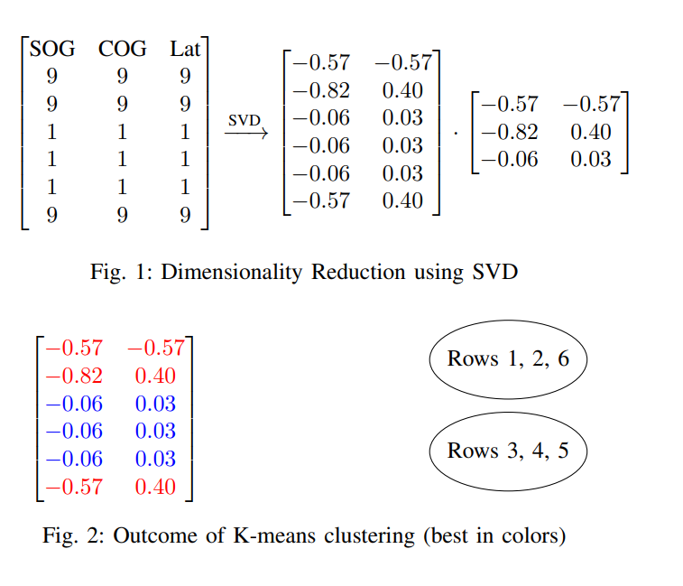
Our Approach

Slide 9
Contributions
We introduced Real-World GPS Data Integration
We applied an Efficient-Enhancing Technique.
We applied advancements in ADD Using GPS Data
We experimentally evaluated our proposed algorithm using real-world datasets. Experimental results and a case study demonstrate that our approach efficiently classified a driver as normal or abnormal based on GPS data records.

Slide 10
Experiment
Our dataset consists of older drivers, typically between the ages of 65 and 85 years. These drivers participated in a research project funded by the National Institutes of Health (NIH), which spanned over three years.
Our experiment was divided into two key phases:
the Training Phase, where we precisely identified distinct driving behavior clusters within individual segments, and
the Testing Phase, which involved evaluating the model's ability to detect abnormal driving behavior using data from two drivers with known outcomes.

Slide 11
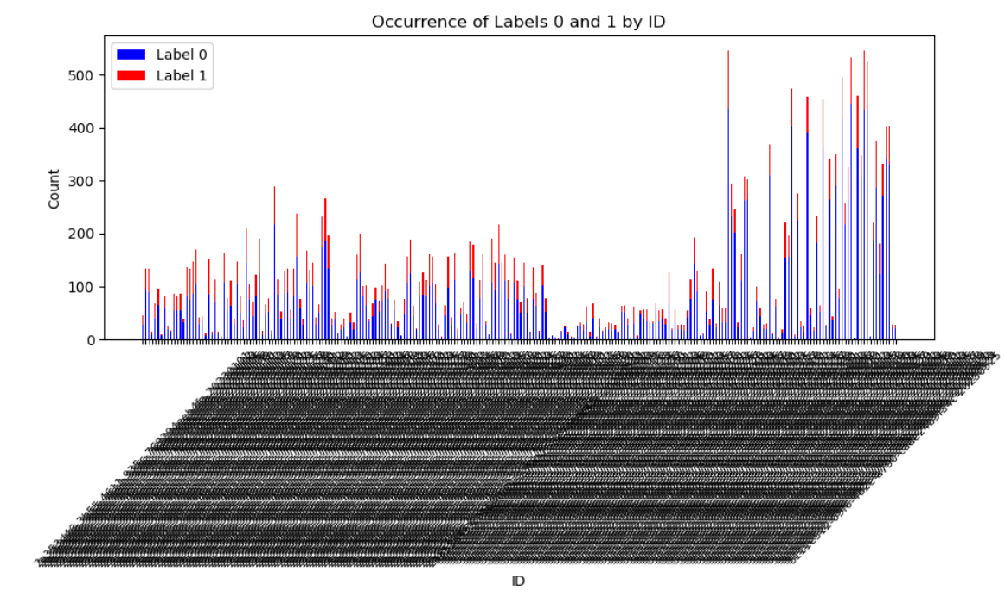
Experiment
We begin to cluster a driving segment for each driver.

Slide 12
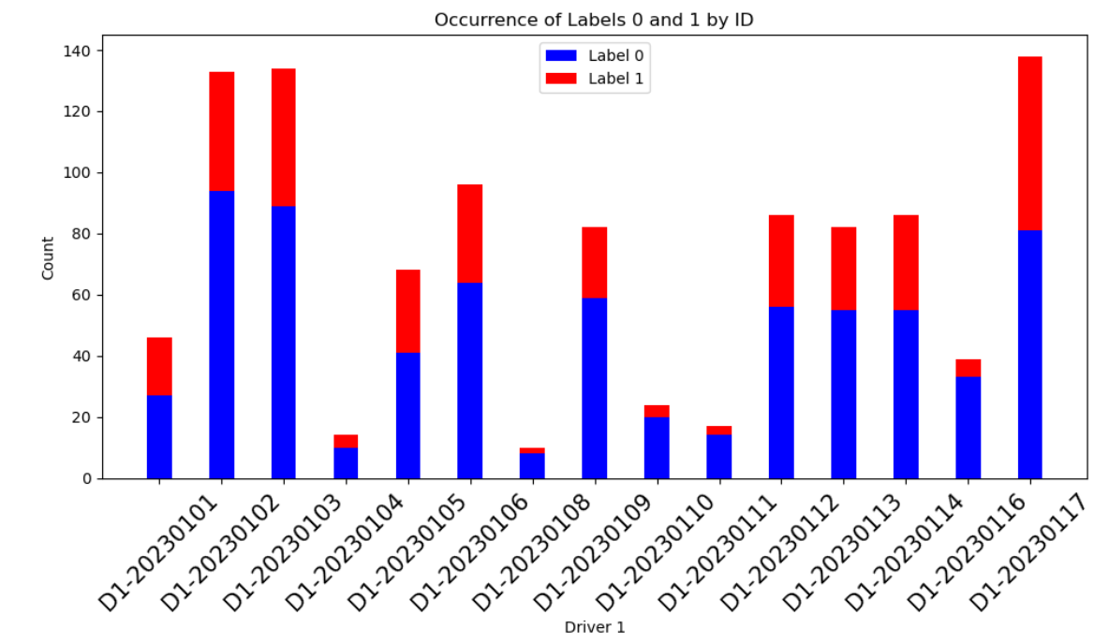
Experiment

Slide 13
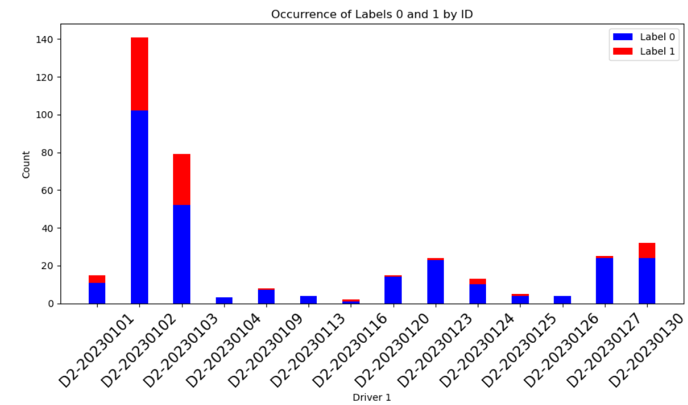
Experiment

Slide 14
Experiment
2. Based on the number of normal and abnormal segments, we cluster each driver by day.

Slide 15
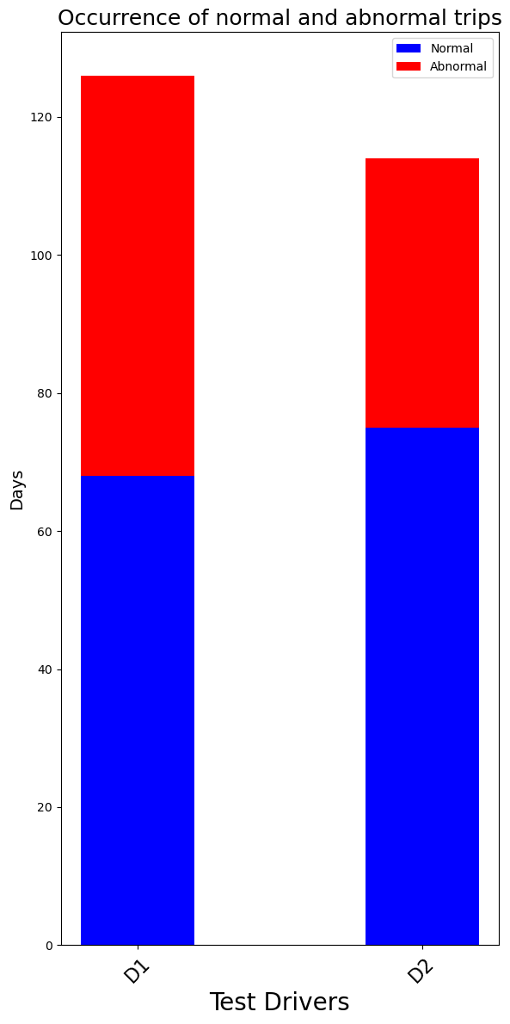

Slide 16
Experiment
3. Based on the number of normal and abnormal days for a driver, we decide if the driver is normal or not.

Slide 17
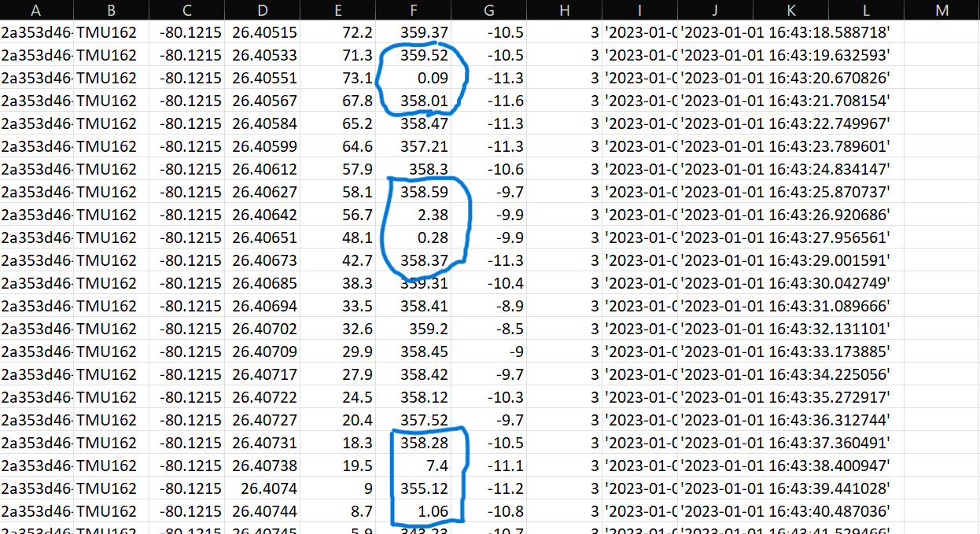
Case Study
Input
Output

Slide 18
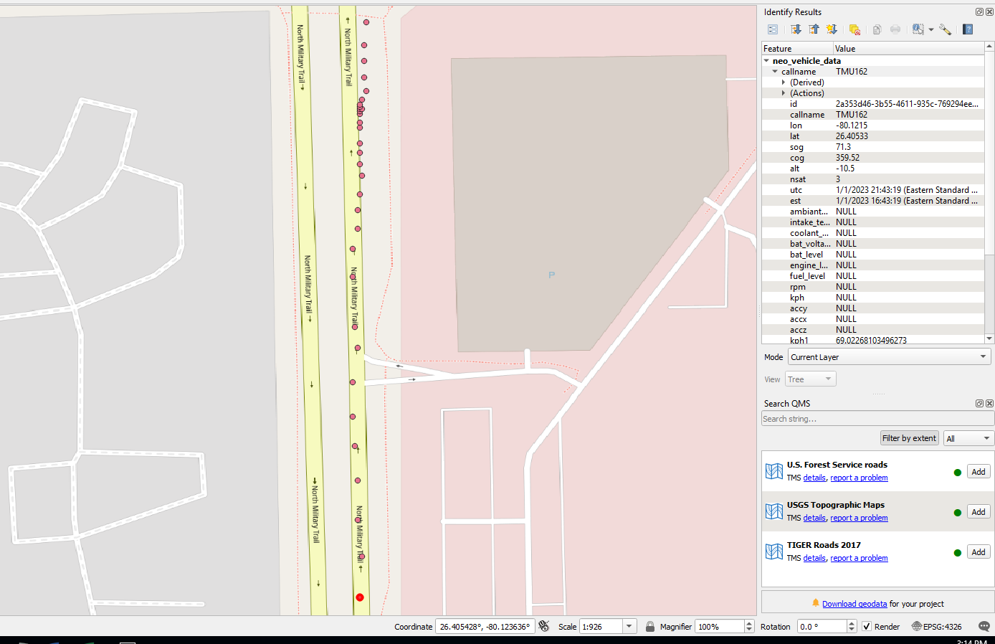
Case Study
Input
Output

Slide 19
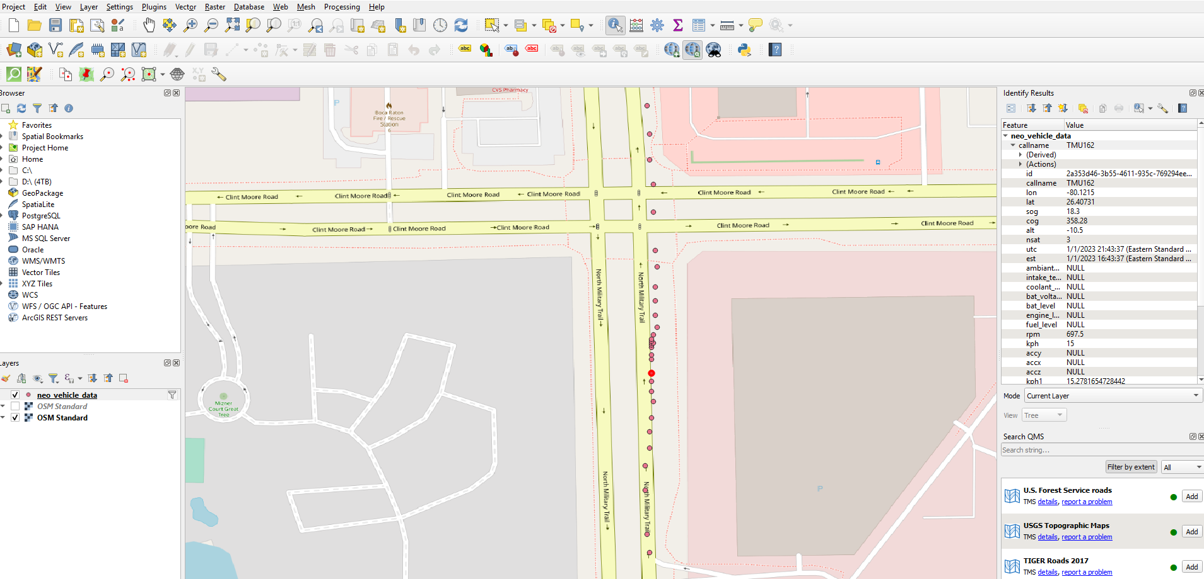
Case Study

Slide 20
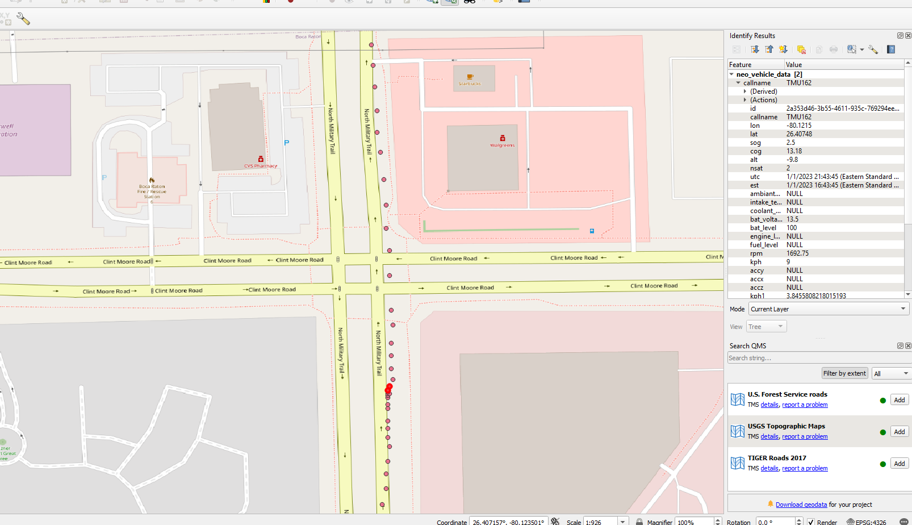
Case Study

Slide 21
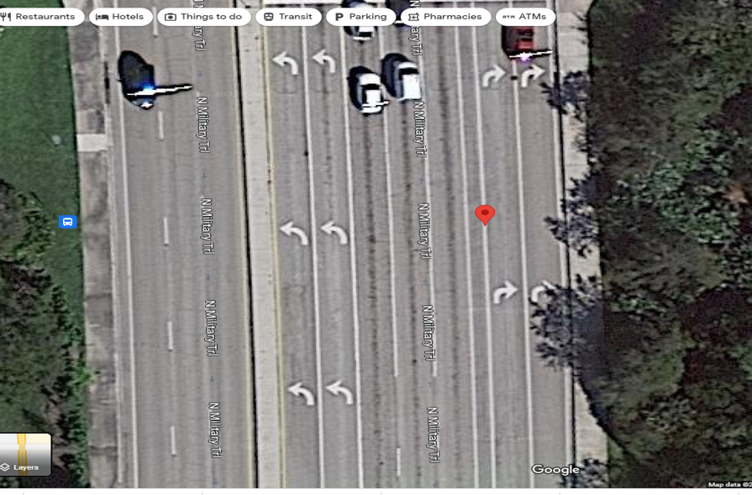
Case Study

Slide 22
Conclusion and Future Work
The ADD problem is important for societal applications notably in the realm of transportation safety.
We suggested using GPS data for extracting real-time driving attributes from drivers, offering a novel approach to leverage this valuable data source.
We proposed the combination of both Singular Value Decomposition and k-means to reduce dimensionality and classify drivers.
Future:
Exploration of the influence of external factors such as weather conditions, road quality, or traffic density on driving behavior.
Incorporating data from other vehicle sensors. Integration of sensor data from accelerometers, gyroscopes, and even cameras could provide a more comprehensive view of driver behavior.
Enhanced classification system, such as a 5-star rating system, could be explored to provide a more nuanced and detailed assessment of driving behaviors.

Slide 23
Q & A

